Slide 1
Webinar Presentation on Peace Studies for Sustainable Development in Africa 22nd December, 2021
Peace and Development Research - Challenges, Boundaries, Bridges, and Opportunities for Inclusive Voicing In Research and Evaluation Outcomes
By
Hippolyt A. S. Pul, PhD
Executive Leader
Institute for Peace and Development

Slide 2
Boundaries of Peace and Development Research and Evaluation: Contentions
Conflicts may erupt and end within short spells of time
but the healing, reconciliation, and the (re)building of peace take very long time to materialize.
The destruction of human relationships and institutional infrastructure during war occur within a twinkle of an eye
But the rebuilding of same can take forever
Those who initiated and oversaw the destructions of war may be long dead and gone
But those who live with the pain and suffering and need healing and reconciliation may be far removed from the events of war and destruction

Slide 3
Contentions Cont’d
Recall of events fade over time
But memories of hurt and hatred can be transgenerational
Peace and development interventions are time-bound,
but the roots of issues and factors that caused and sustained poverty and conflict are timeless.
Peace and development research and evaluation agendas are bounded by timeframes (delimited coverage timeframes, defined timelines for the execution of the assignment)
but the memories and stories of those affected go deep and fa – unbounded by time.

Slide 4
Peace and Development Research and Evaluation: Purpose and Mandates
Research and evaluations on development and peace are based on
predetermined learning objectives rooted in
pre-defined hypotheses
theories of change
Research and Evaluation designs
Mandate pre-definition of research and evaluation boundaries – i.e. what observable change the research and evaluations should validate or reject.
Follow prescriptive models or pathways to establishing how change happens
Presume linear pathways to change
Anticipate generalizable conclusions from collected data

Slide 5
Peace and Development Research and Evaluation: The Challenge
Therefore, determination of what issues to cover in a peace and development agenda, which people are invited to tell their stories of pain and suffering, and what timelines should be included in peace and development research or evaluations can be contentious.
Inclusivity Challenges
Issues
Target Participants
Periodization

Slide 6
Hettne’s Challenge to Conventional Thinking
Need to distinguish between “problem-oriented and solution-oriented research” (Hettne (1983) in dealing with the interlink between peace and development.
Causal models of analysis tend to
propose linear and prescriptive linkages between causes and effects
But a reversal of the causal links could reveal alternate perspectives of how peace and development might be achieved.
Qualifier of “development of another kind” raises the questions:
Is there an alternative view of development different from the orthodox one?
If yes, whose view is that and how does it differ from the orthodox view?
Hettne’s Query
Should we “…conceive of disarmament as a condition for development, [or] argue that development — that is development of another kind — is a condition for disarmament” (Hettne, 1983, p.1).

Slide 7
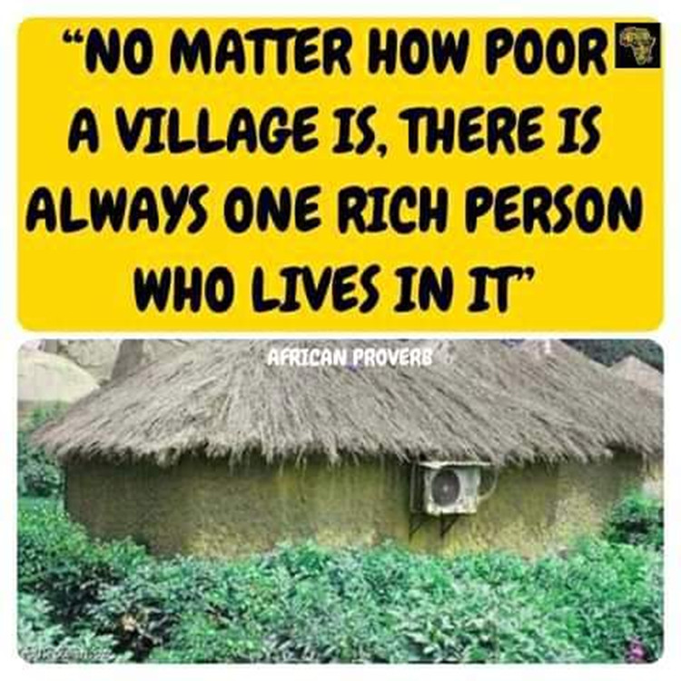
The Search for Common Grounds
My Development, Not Your Development; My Peace, Not your Peace
Measures of what constitutes development are contextual (culturally) and therefore experiential and subjective.
Similarly, peace is experiential, and therefore, relative in its manifestation and assessment.
What I prize as development may appear abject poverty to you.
What counts for peace for one does not necessarily equate to peace for another

Slide 8
Perceptions of conflicts differ
Conflicts are not necessarily dualistic - the dualistic perception of conflict does not hold true for everyone.
The We; not I, not you, not them worldview on conflicts means
people may not see conflicts as a “we versus them” dynamic
collectivization of responsibility for conflict and peace valued over individualization
The “other” may be undefinable - (Cite “We don’t know who killed us” )
perceptions of conflicts affects the evolution and dynamics of conflicts in non-linear and timeless ways.
The guns may be silent, but the memories run deep into history and project long into the future
affecting the dead, the living, and the unborn.
Giving life and meaning to new signs, symbols, and narratives of the moment

Slide 9
The Longer Now
Conflicts seldom have single causes and their raison d’être seldom born of the present:
causes are often convoluted and historically deep rooted.
Therefore, resolutions cannot be from acts of the moments; they reside in and emanate from the hearts and memories of people.
The processes and paces of reflection, healing, forgiveness, and reconciliation are individualized, not collectivized and timed.

Slide 10
Conceptual Implications For Research And Evaluation Design
Setting the Boundaries between peace and development research

Slide 11
Implications on Research and Evaluation Design
To what extent is there agreement on what triggered the conflicts? What would lead to resolution? What would sustain them?
Are the indicators of conflict, peace, and development that researchers and evaluators track the same measures that those who lived through them would prioritize as indicators of progress, retrogression, or stagnation in their situation?
To what extent is there coincidence of perspectives between donors/sponsors, implementing partners, and members of participating communities on what counts?
What counts may not be countable and what is countable may not count
Facts and figures indicate movement, but FEELINGS decide what is peace and development

Slide 12
The Siamese twins of Peace and development
In Africa, conflict, peace, and development are inextricably interlinked as they are often mutually causative
Development deficit often a source of conflicts, just as conflicts create development deficits.
Conflict situations, often induce leadership voids in the delivery of development and social services.
In conflict situations leadership deficits create opportunities for reimagining development and peace
Peace and development often viewed as synonyms, not disparate concepts.

Slide 13
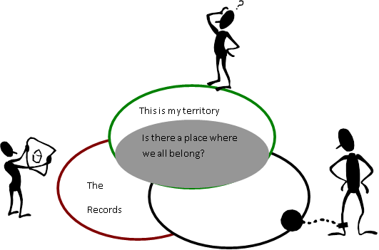
Meaning making
To understand why communities fight, you must follow their Meaning making processes:
incidents that trigger conflict mean different things to different people:
facts can/are interpreted differently;
what seems insignificant and ludicrous trigger of violence has deep, hurtful meaning to others (e.g.: the guinea fowl war, the mango war, the hoe war etc. in Northern Ghana).
But meanings are personalized, subjective and can only be understood from different perspectives.
This is mine

Slide 14
Challenges of Peace and Development Research & Evaluation Design
The Snapshot Versus Video View of Peace
“If you look at our situation from the perspective of an outsider, you will have a snapshot view of it. In that case you will say there is no peace. But if you look at our current situation from the perspective of those of us who have lived here, you will have a video perspective, then you will know that there is peace”. Senior Clergy of Goma Diocese, October 2010
Definitional Challenges
What Development?
Whose Development?
What peace?
Whose Peace?
One person’s development is another’s impoverishment
One person’s peace is another’s tribulations

Slide 15
Methodological Challenges: Representation
Balancing External Power and Local Interests: How do you accurately represent the views of those whose peace and development you seek to assess while meeting the demands those who commissioned and paid for the research or evaluation?
Navigating between Orthodoxy to heterodoxy: How does peace and development research contribute to greater equity in the representations in conflict narratives (increasing heterogeneity in the narrative construction processes) without upsetting local power balances?
Sampling Diversity, Equity, and Inclusion (DEI):
how do you ensure that the views of all subcategories of citizens are equitably represented in your sample frame?
How do you engage and make the voices and views of the aggrieved, the grieving, and the aggressors heard and count in equal measure in your analysis and reporting?
Equity and Cost containment: How do you ensure your sample size and sampling process create spaces for different categories of participants with limited resources (time, money, personnel, logistics).

Slide 16
Finding the findings: The Planned vs. Unplanned; the Intended vs. Unintended
Yobe and Borno States, North-eastern Nigeria:
Youth Peace Platforms (YPPs) formed to promote peace and security used community
But the prized achievement of the YPPs are the development initiatives (promoting environmental hygiene, rehabilitation of mosques, provision of potable water, etc.) they promoted as entry points for mobilizing destabilized communities to confront Boko Haram and allied forces.
What is success?
Whose success?
How is it measured?
What is desirable?
Whose desirable outcomes?

Slide 17
The Planned vs. Unplanned; the Intended vs. Unintended
From Fighters to
Indispensable service providers
Active portal for state-citizens’ engagement
Champions of community development initiatives
In Liberia, Monrovia and Nimba County
Members of Federation of Motorcycle and Tricycles Union of Liberia (FOMTUL), a union of largely former combatants in Liberia’s civil war was formed to defend the motorcycle and tricycle transport operators against GoL’s attempts to proscribe their only means of livelihood.
Created a civilian-police interface for promoting peace and security
Leveraged its nationwide network to provide logistics support to Liberia’s election management body

Slide 18
Reporting as Bridging Opportunities
The Peacebuilding Researcher and Evaluator
The Academic or
The Practitioner
How do you to convey the voices and views of the people engaged in the research process and yet maintain an objective distance from the emotions and living traumas you encountered while engaging them.

Slide 19
Reporting as Narrative Construction
Reporting is narrative construction: How does the researcher bring out the reality of what is, with the people he or she engages especially in respect of magnifying the voices and views of subaltern groups, the oppressed without courting accusation of empathy?
Solution Inadequate
I use anonymized direct quotes as much as possible to preserve the authenticity of voices and views in the reporting.
However, juxtaposing, linking, de-linking, and weaving different voices and views into a consistent and meaningful narrative is like painting a picture on a canvass
in which process the emotions of the artist and the art are one.

Slide 20
Reporting is Representation
Whose narratives of conflict, peace, and development are we representing? – mindful of orthodoxy and heterodoxy
whose view of development is development?
Whose concept of peace is peace?
Is there space for accommodating alternative worldviews?
Is there space for an inclusive narrative where your story and mine become our story?
Is there a role for the peace/development researcher in facilitating this convergence?
Researcher/Evaluator vs Facilitator
Research and evaluation reports can easily be possessed as part of recorded history of a conflict.
How does the researcher/evaluator through documenting findings, facilitate the convergence of narratives as the meeting point for healing, peace, and reconciliation to happen?

Slide 21
Reporting as Messengering
Some research/evaluation participants may be highly traumatized, marginalized, criminalized, or ostracized individuals and groups whose voices may never have been heard
the Zogo and Zoges in Liberia – ex-child soldiers taking refuge in drugs and earning their living through crimes
Satan’s Field gangsters in Plateau Stat
King of Bunyoro-Kitara, Hoima
Gaining access to them to listen to their stories, their pains, and their views requires building trust and confidentiality with them.
In return for granting access, they may see the researcher as their “porte-parole” to the world –
one to tell their stories and articulate their views on peace and development to the world – policy makers, development agencies, etc.
Researcher versus Porte-parole role
Challenge: How does the researcher deliver on the trust and faith reposed in him or her and yet be able to report objectively on outcomes of the research, especially in longitudinal research or evaluation settings?

Slide 22
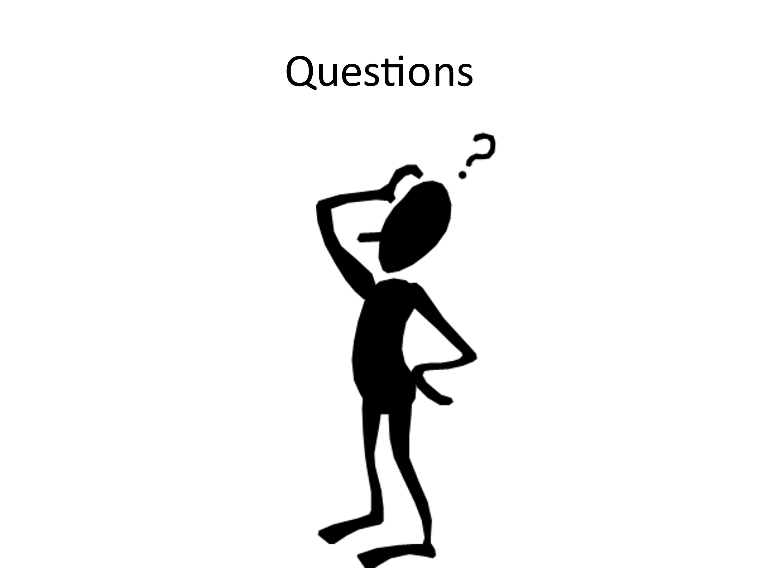

Slide 23
References
Hettne, B. (1983). Peace and Development Contradictions and Compatibilities. Journal of Peace Research, 20(4), 329–342. http://www.jstor.org/stable/424167

